Slide 1
The Influence of Learned Versus Instructed Target Features on Attentional Control Settings
Markus Grüner¹, Florian Goller², Ulrich Ansorge¹
markus.gruener@univie.ac.at
https://homepage.univie.ac.at/markus.gruener/
https://orcid.org/0000-0002-0869-4081
¹ University of Vienna, Austria
³ Austrian Marketing University of Applied Sciences

Slide 2
Top-down Influences on Visual Attention
Visual Attention
Selective processing of visual information, facilitating some aspects over others (e.g., Carrasco, 2011)
Top-down influence = influence of knowledge
Controlled orienting of attention (e.g., Helmholtz, 1894; Posner, 1980)
Involuntary orienting towards target-matching stimuli (Folk et al., 1992)

Slide 3
Difference between learning and instruction?
Top-down attentional guidance is often investigated using visual search tasks
With adult humans: Instruction to search for a target (feature)
With pre-verbal humans and non-human animals: Learning the target (feature)
Learning effects can influence visual attention independent of top-down effects
Statistical learning (Wang & Theeuwes, 2018)
Contextual cueing (Chun & Jiang, 1998)
Value-driven attentional capture (Anderson et al., 2011)
Comparison might be flawed

Slide 4
Experiment 1
Comparing the influence of learning and instruction on visual attention
21 participants (15 women, 6 men) between 19 and 39 years (Mdn = 24)
Block 1: Learning the target feature
Via trial and error (positive feedback as reward)
Block 2: Instruction to search for the target feature

Slide 5
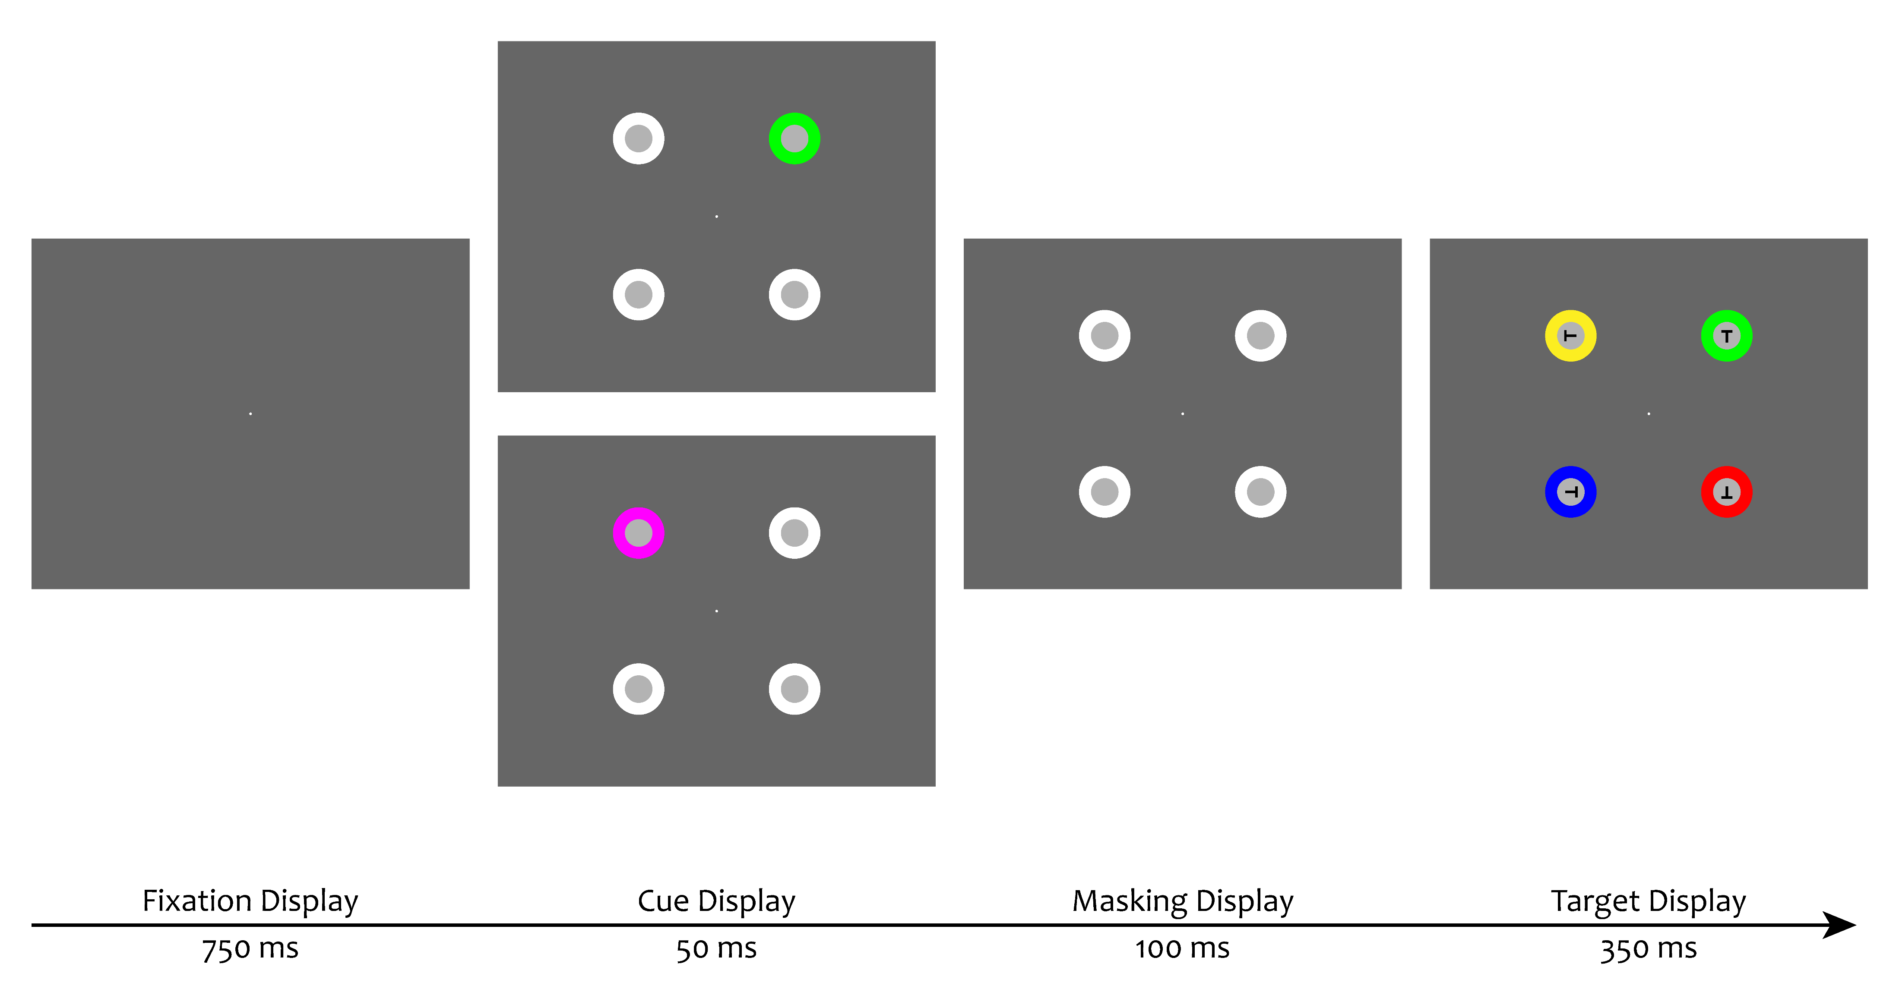
Design
Valid matching cue
Target
Invalid non-matching cue

Slide 6
Data Analysis
Validity effects for each cue condition (match vs. non-match)
Mean reaction time differences between invalid and valid trials
Valid = cue appeared at the same position as the target
Invalid = cue appeared at the different position as the target
Positive validity effects indicate attentional capture by the cue
Accuracy
Rolling mean of correct responses during the last 20 trials.

Slide 7
Validity Effects (Invalid Minus Valid Reaction Times)

Slide 8
Learning Curve and Contingency Effect in Experiment 1

Slide 9
Discussion
Only matching cues captured attention
No difference between learning and instruction
The learned stimulus had no other value except defining the target
Learning this association results in knowledge about the target feature
As does the instruction
Learning via trial-and-error might work as an indirect instruction

Slide 10
What aspects distinguish learning and instruction?
Instruction creates knowledge about the search criterion
Influence should be highly dependent on using that search criterion
Learning influences attention independent of the used search criterion
Learning effects do not vanish when the search criterion changes

Slide 11
Experiment 2
Combining spatial cueing with a redundant relevant cue task (Trabasso & Bower, 1968)
The target is defined by two features, color and orientation
Each feature is enough to identify the target
23 participants (19 women, 4 men) between 18 and 30 years (Mdn = 20)

Slide 12
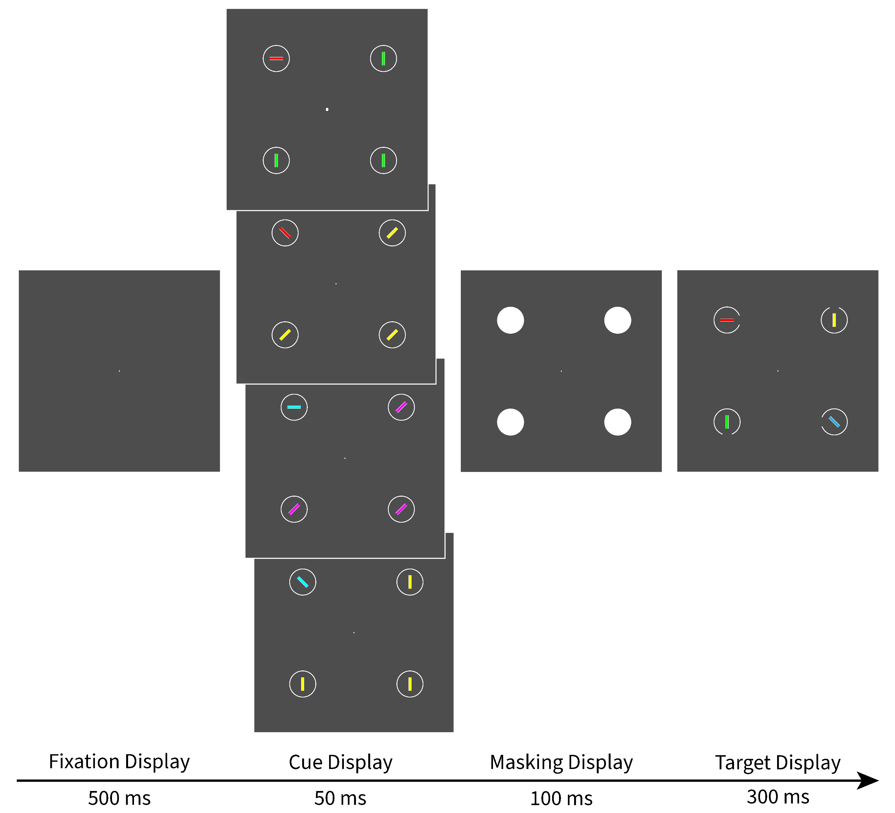
Design
Full-match
Target
Color-match
Orientation-match
Non-match

Slide 13
Learning Results
All participtants reported learning first the color as target-defining
13 (from 23) noticed additionally orientation as target-defining

Slide 14
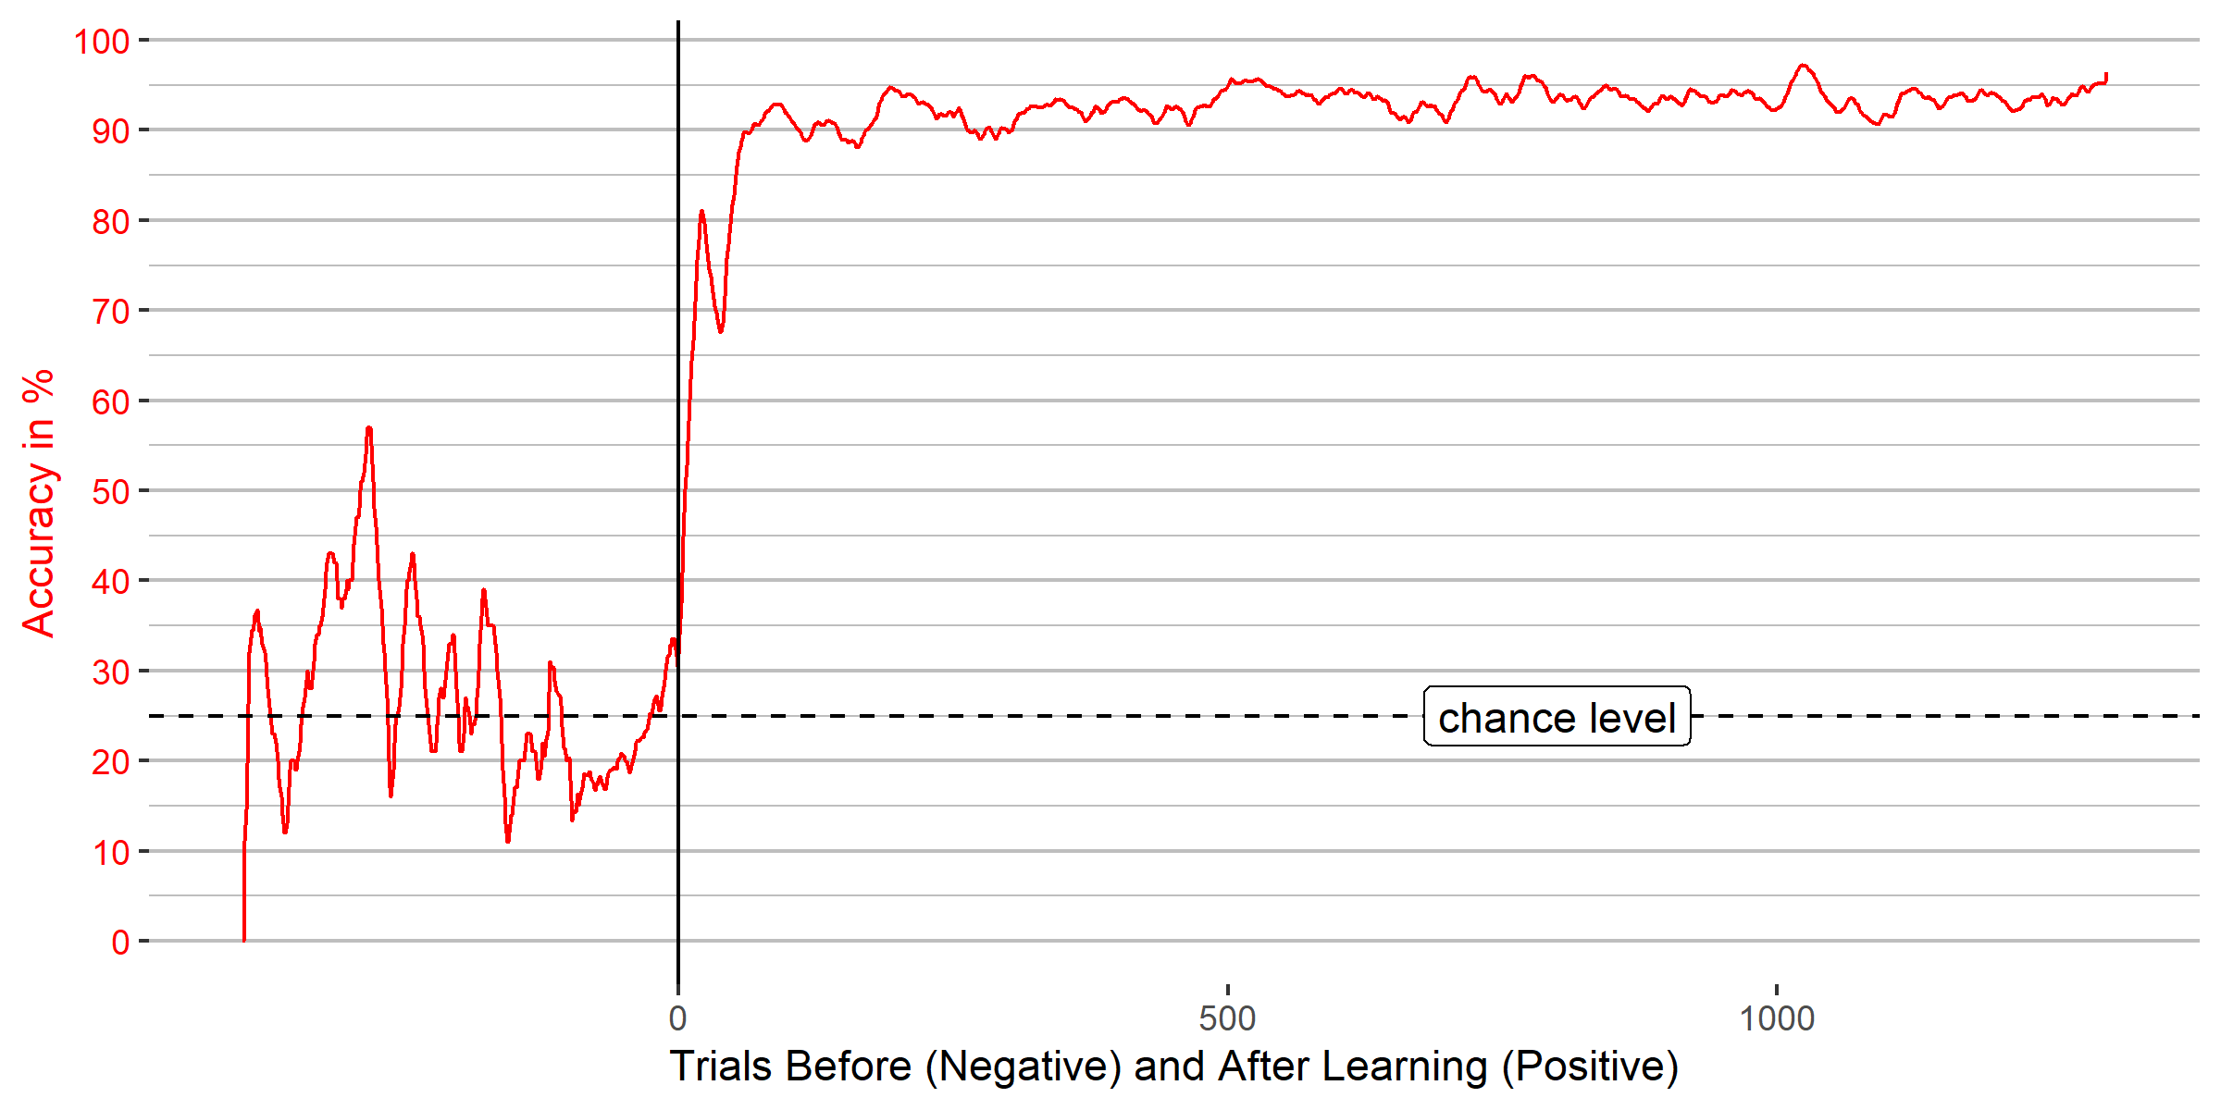
Learning Curve in Experiment 2

Slide 15
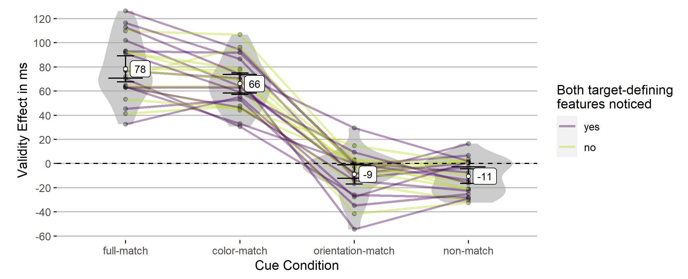
Validity Effects (Invalid Minus Valid Reaction Times)

Slide 16
Influence of noticing both target-defining features
Contrast | M (SD) | 95% CI | t(df) | p | d_{unb} | 95% CI
full-match – color-match
Both features noticed | 18 (20) ms | [6, 30] | 3.17(12) | .032 | 0.82 | [0.22, 1.51]
Only color noticed | 5 (14) ms | [−5, 15] | 1.11(9) | .595 | 0.32 | [−0.3, 0.98]
orientation-match – non-match
Both features noticed | −2 (18) ms | [−13, 9] | −0.45(12) | .662 | −0.12 | [−0.67, 0.42]
Only color noticed | 7 (12) ms | [−2, 15] | 1.78(9) | .327 | 0.51 | [−0.12, 1.22]

Slide 17
Diskussion
Attentional capture contingent on search criterion
Small effect of noticing both target-defining features (a learning effect?)
only additionally to the top-down matching feature
No effect of the non-used target feature
No evidence for priming effects
Learning = indirect instruction?
Learning effects have an prolonged influence on attention
Top-down effects should change swiftly if the search criterion changes

Slide 18
Experiment 3
Changing target-defining feature in Block 2
First color, then orientation
Between-participants groups Learning vs. Instruction
Learning new feature (orientation) 22 participants (18 women, 4 men) between 18 and 26 years (Mdn = 20.50)
Instruction of new feature (orientation) 21 participants (15 women, 6 men) aged between 18 and 30 years (Mdn = 20)

Slide 19
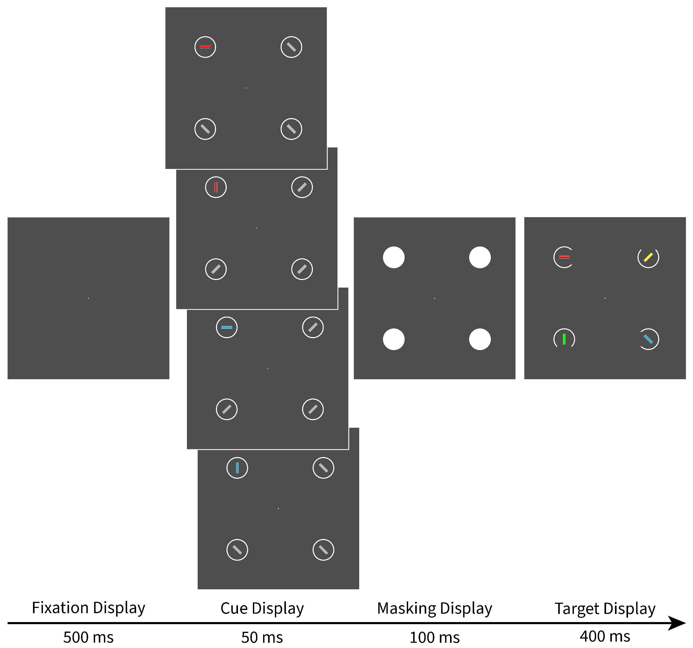
Design
Color and Orientation Match
Target
Color Match
Orientation Match
Non-match

Slide 20
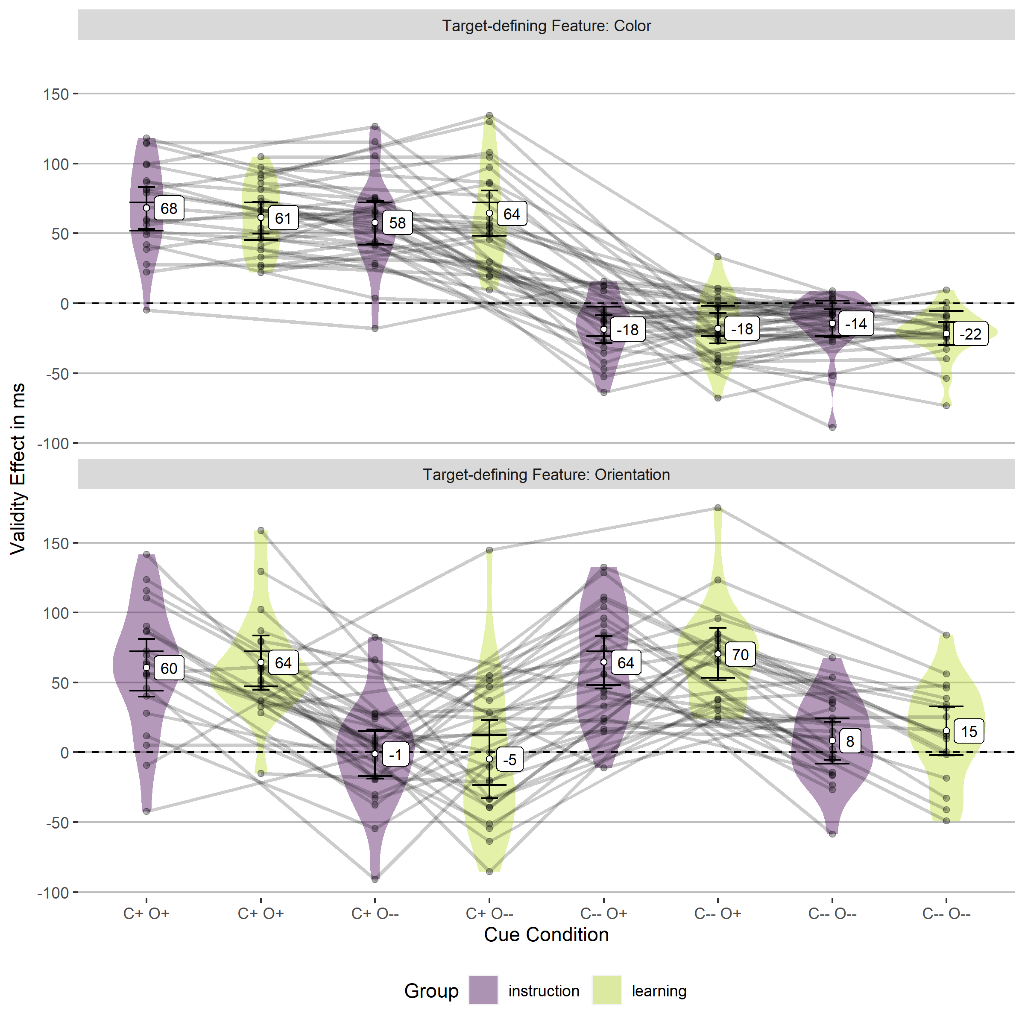
Validity Effect (Invalid Minus Valid Reaction Times)

Slide 21
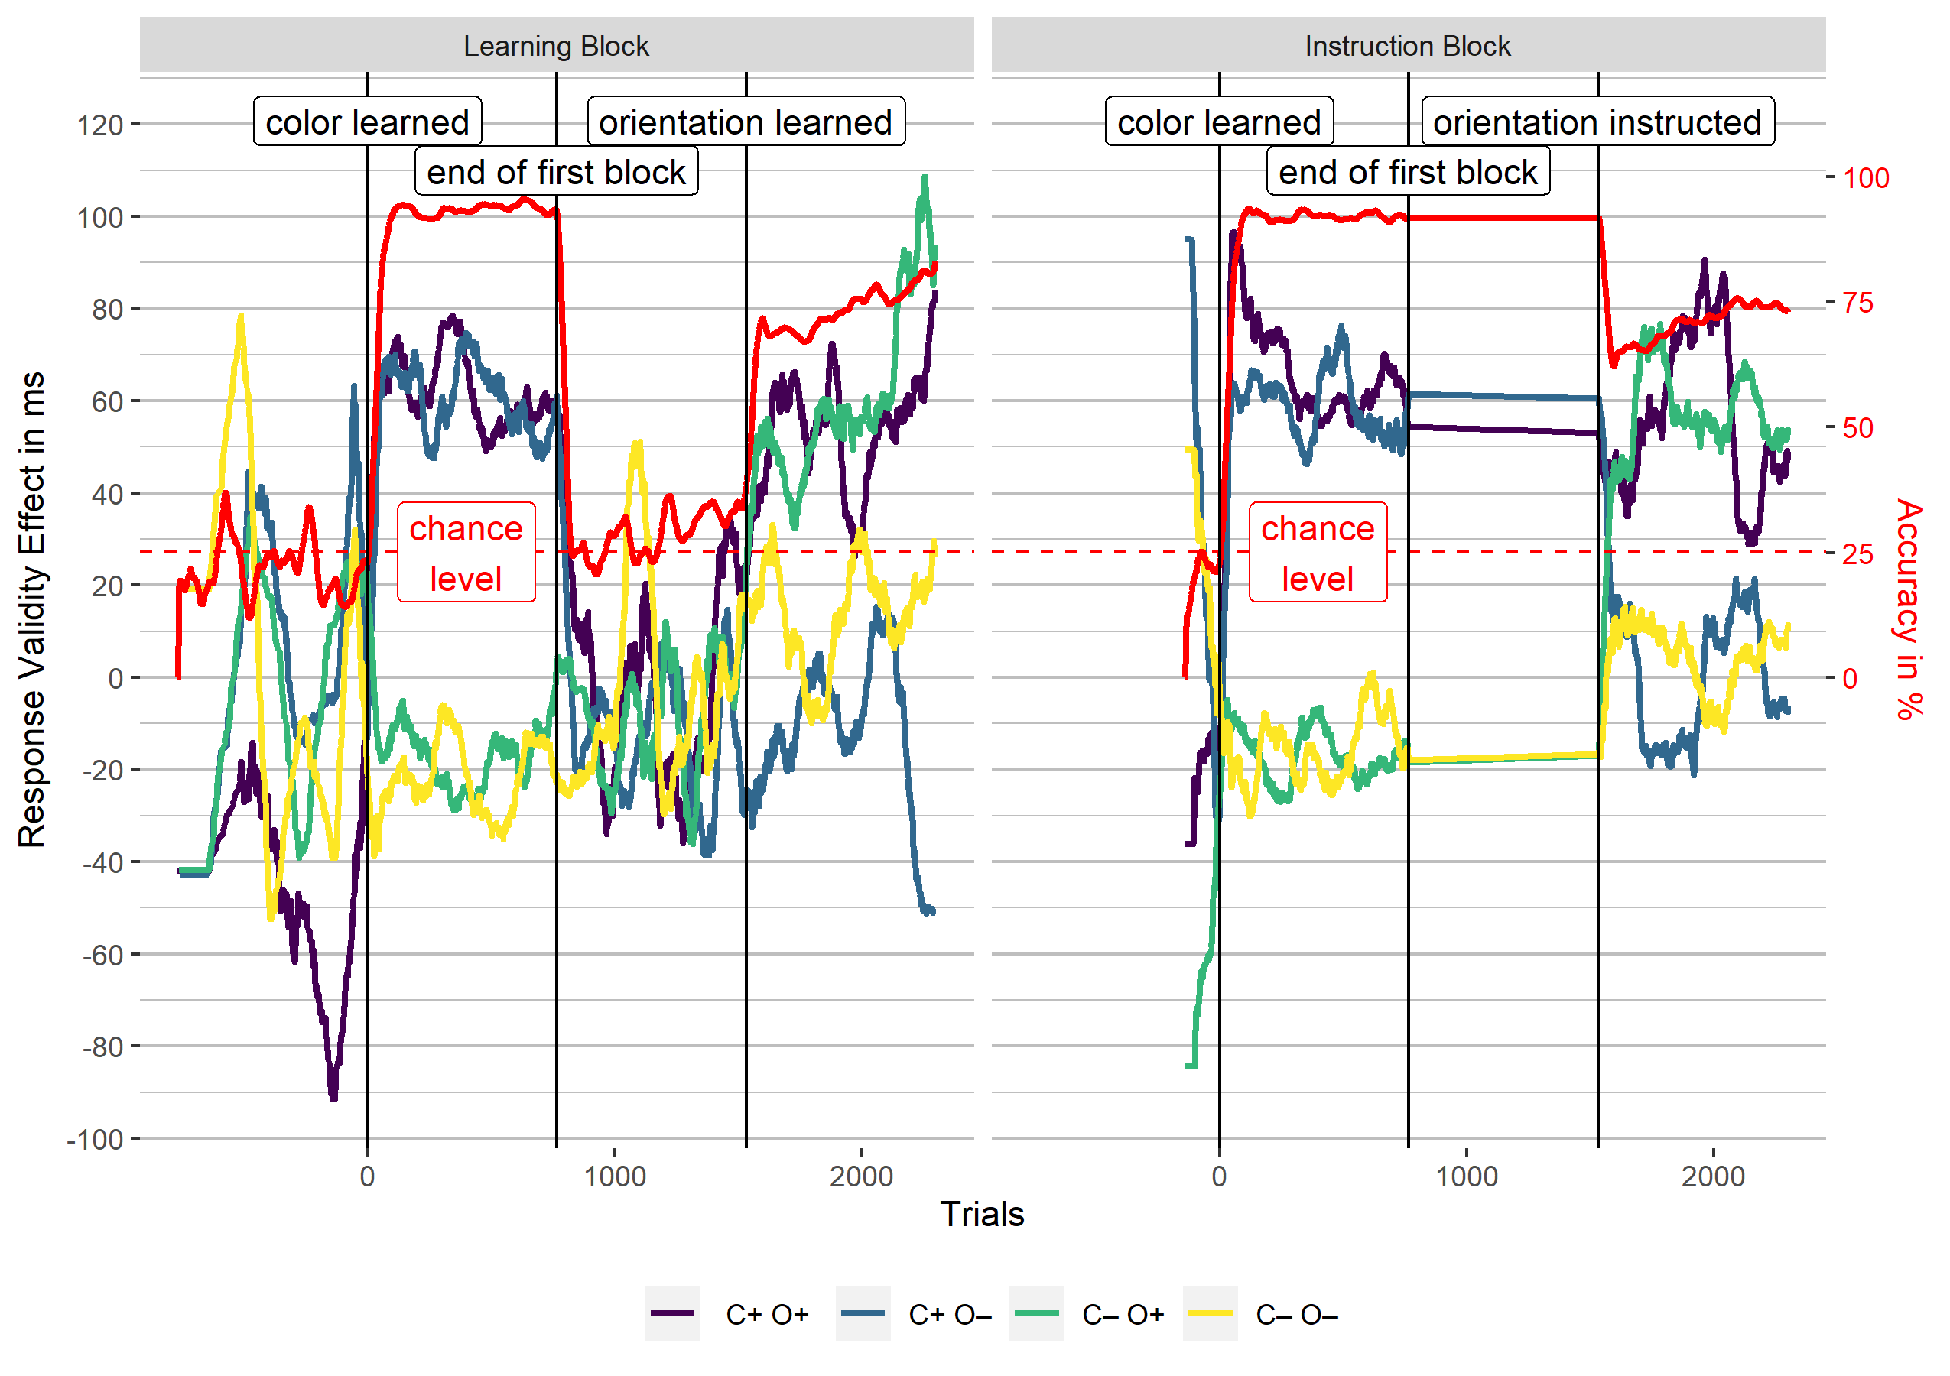

Slide 22
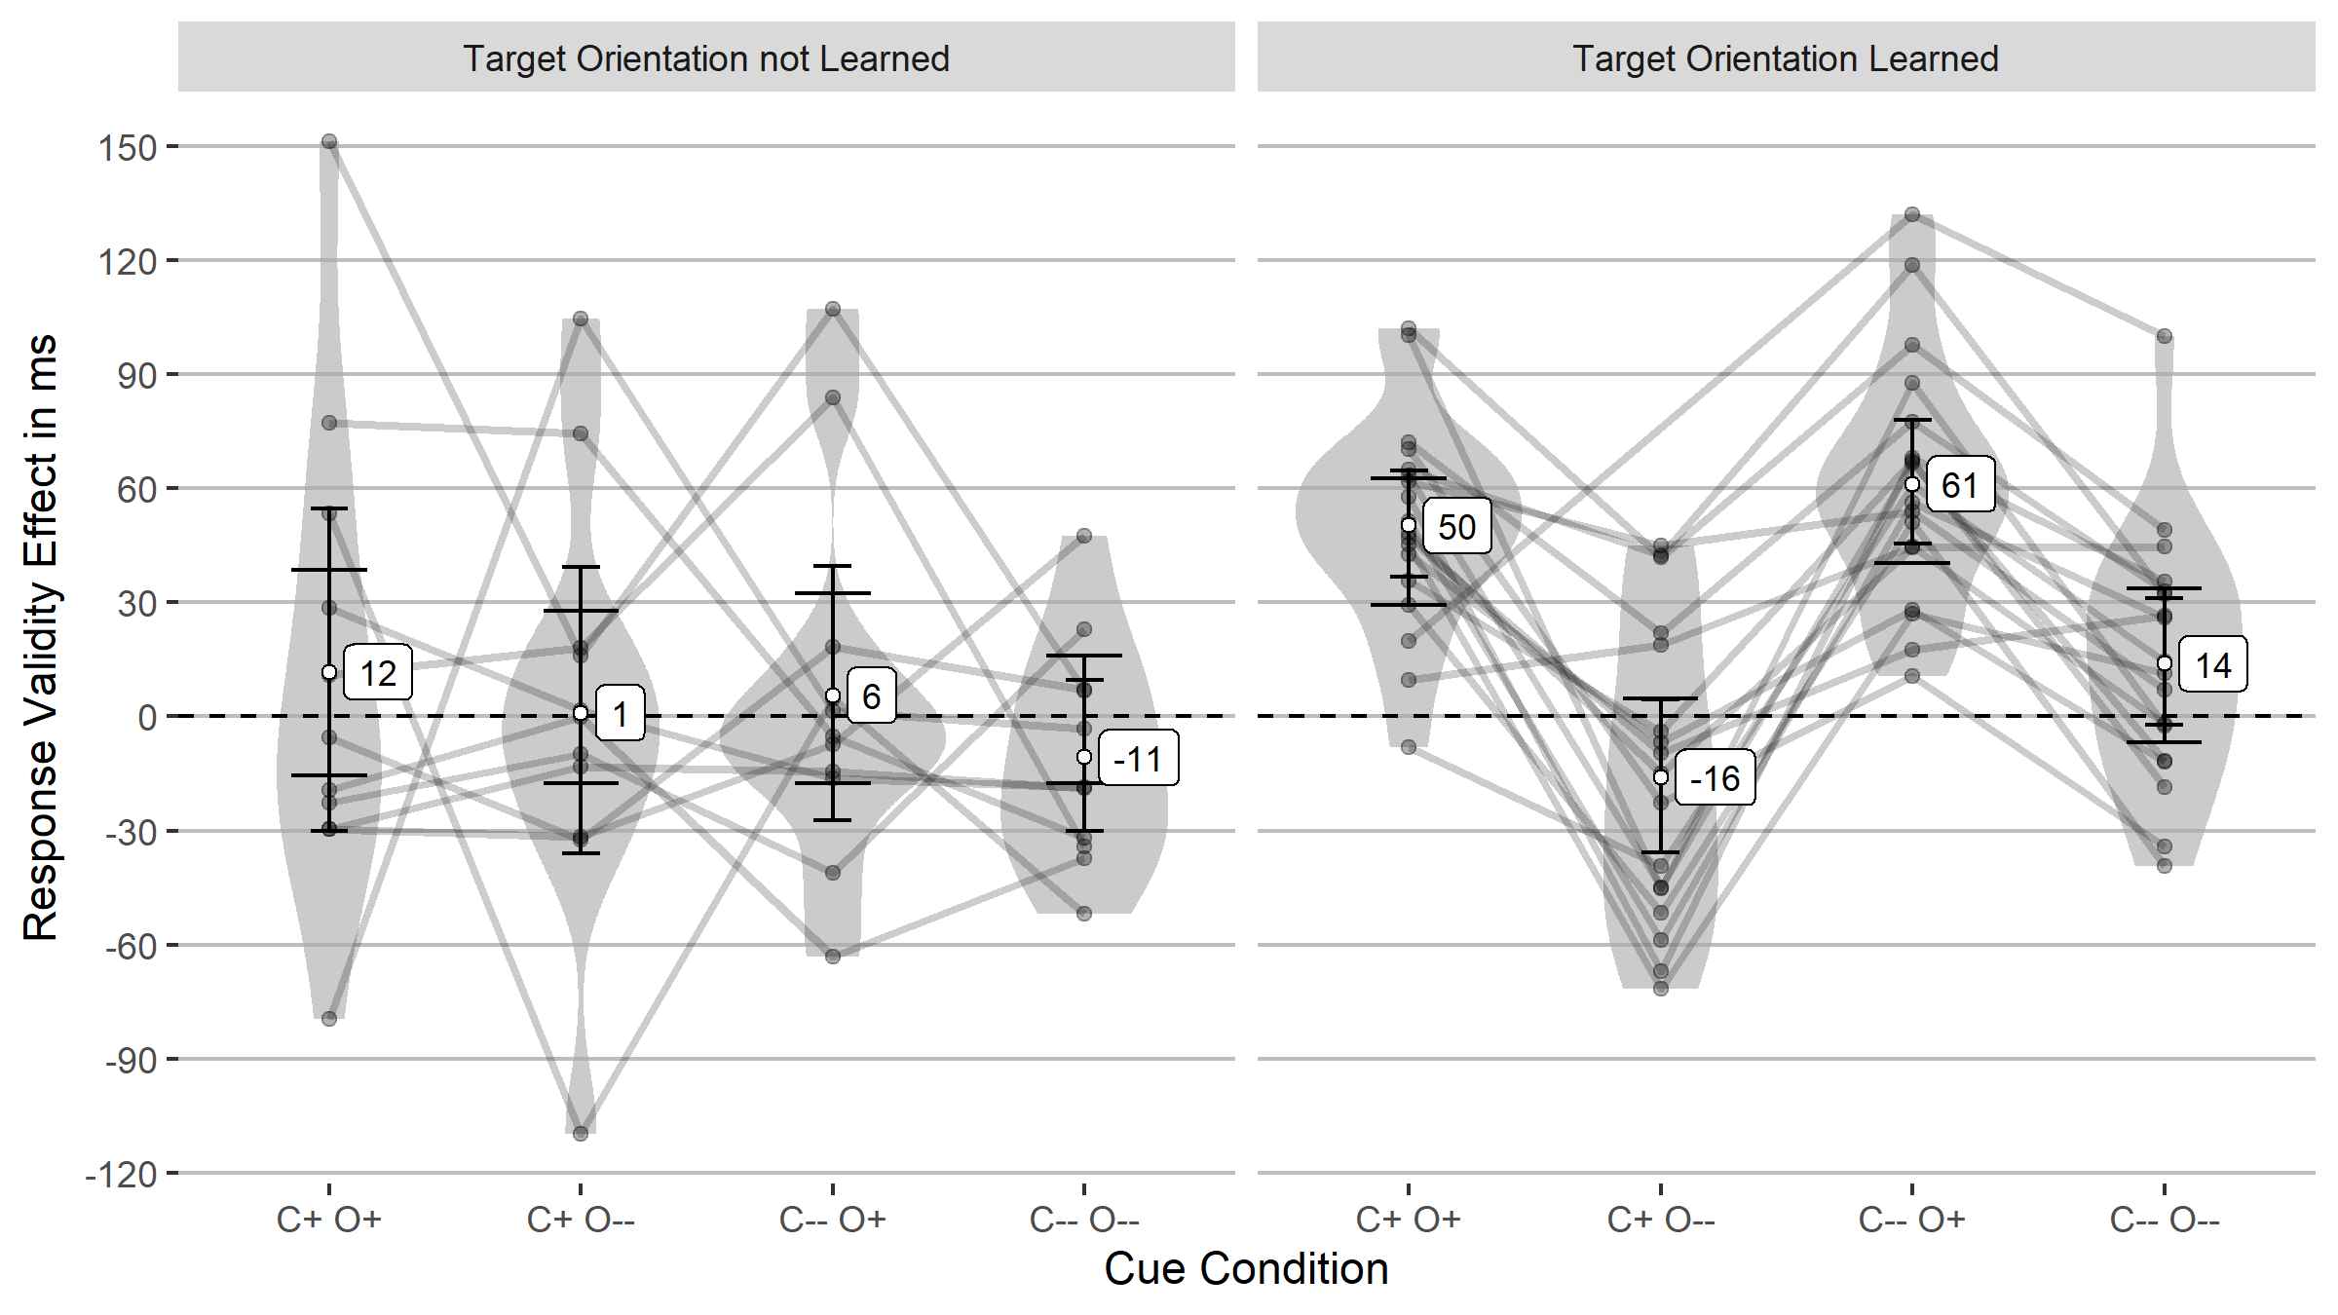
Validity Effects before and after orientation is learned

Slide 23
General Discussion
Our results indicate that learning elicited the same attentional control settings as instruction
Learning = indirect instruction?!
Studies using instruction and learning might investigate the same (top-down) attentional mechanisms
As long as the target feature is completely predictive
The only value of the target feature is being target-defining

Slide 24
References
Anderson, B. A., Laurent, P. A., & Yantis, S. (2011). Value-driven attentional capture. Proceedings of the National Academy of Sciences, 108(25), 10367–10371. https://doi.org/10.1073/pnas.1104047108
Carrasco, M. (2011). Visual attention: The past 25 years. Vision Research, 51(13), 1484–1525. https://doi.org/10.1016/j.visres.2011.04.012
Chun, M. M., & Jiang, Y. (1998). Contextual cueing: Implicit learning and memory of visual context guides spatial attention. Cognitive Psychology, 36(1), 28–71. https://doi.org/10.1006/cogp.1998.0681
Folk, C. L., Remington, R. W., & Johnston, J. C. (1992). Involuntary covert orienting is contingent on attentional control settings. Journal of Experimental Psychology: Human Perception and Performance, 18(4), 1030–1044. https://doi.org/10.1037/0096-1523.18.4.1030
Helmholtz, H. von. (1894). Über den Ursprung der richtigen Deutung unserer Sinneseindrücke [The origin and correct interpretation of our sense impressions]. Zeitschrift für Psychologie und Physiologie der Sinnesorgane, 7, 81–96.
Posner, M. I. (1980). Orienting of attention. Quarterly Journal of Experimental Psychology, 32(1), 3–25. https://doi.org/10.1080/00335558008248231
Trabasso, T., & Bower, G. H. (1968). Attention in learning: Theory and research. John Wiley & Sons.
Wang, B., & Theeuwes, J. (2018). Statistical regularities modulate attentional capture independent of search strategy. Attention, Perception, & Psychophysics, 80(7), 1763–1774. https://doi.org/10.3758/s13414-018-1562-3

