Slide 1

The influence of task-relevance and awareness on reward-driven attentional capture
Markus Grüner
markus.gruener@univie.ac.at

Slide 2



Visual Attention
Selective processing of visual information
Bias toward a feature or location
What influences selection?
Bottom-up (stimulus-driven)
Top-down (goal-driven)
Selection history (memory-driven)
E.g., reward history

Slide 3
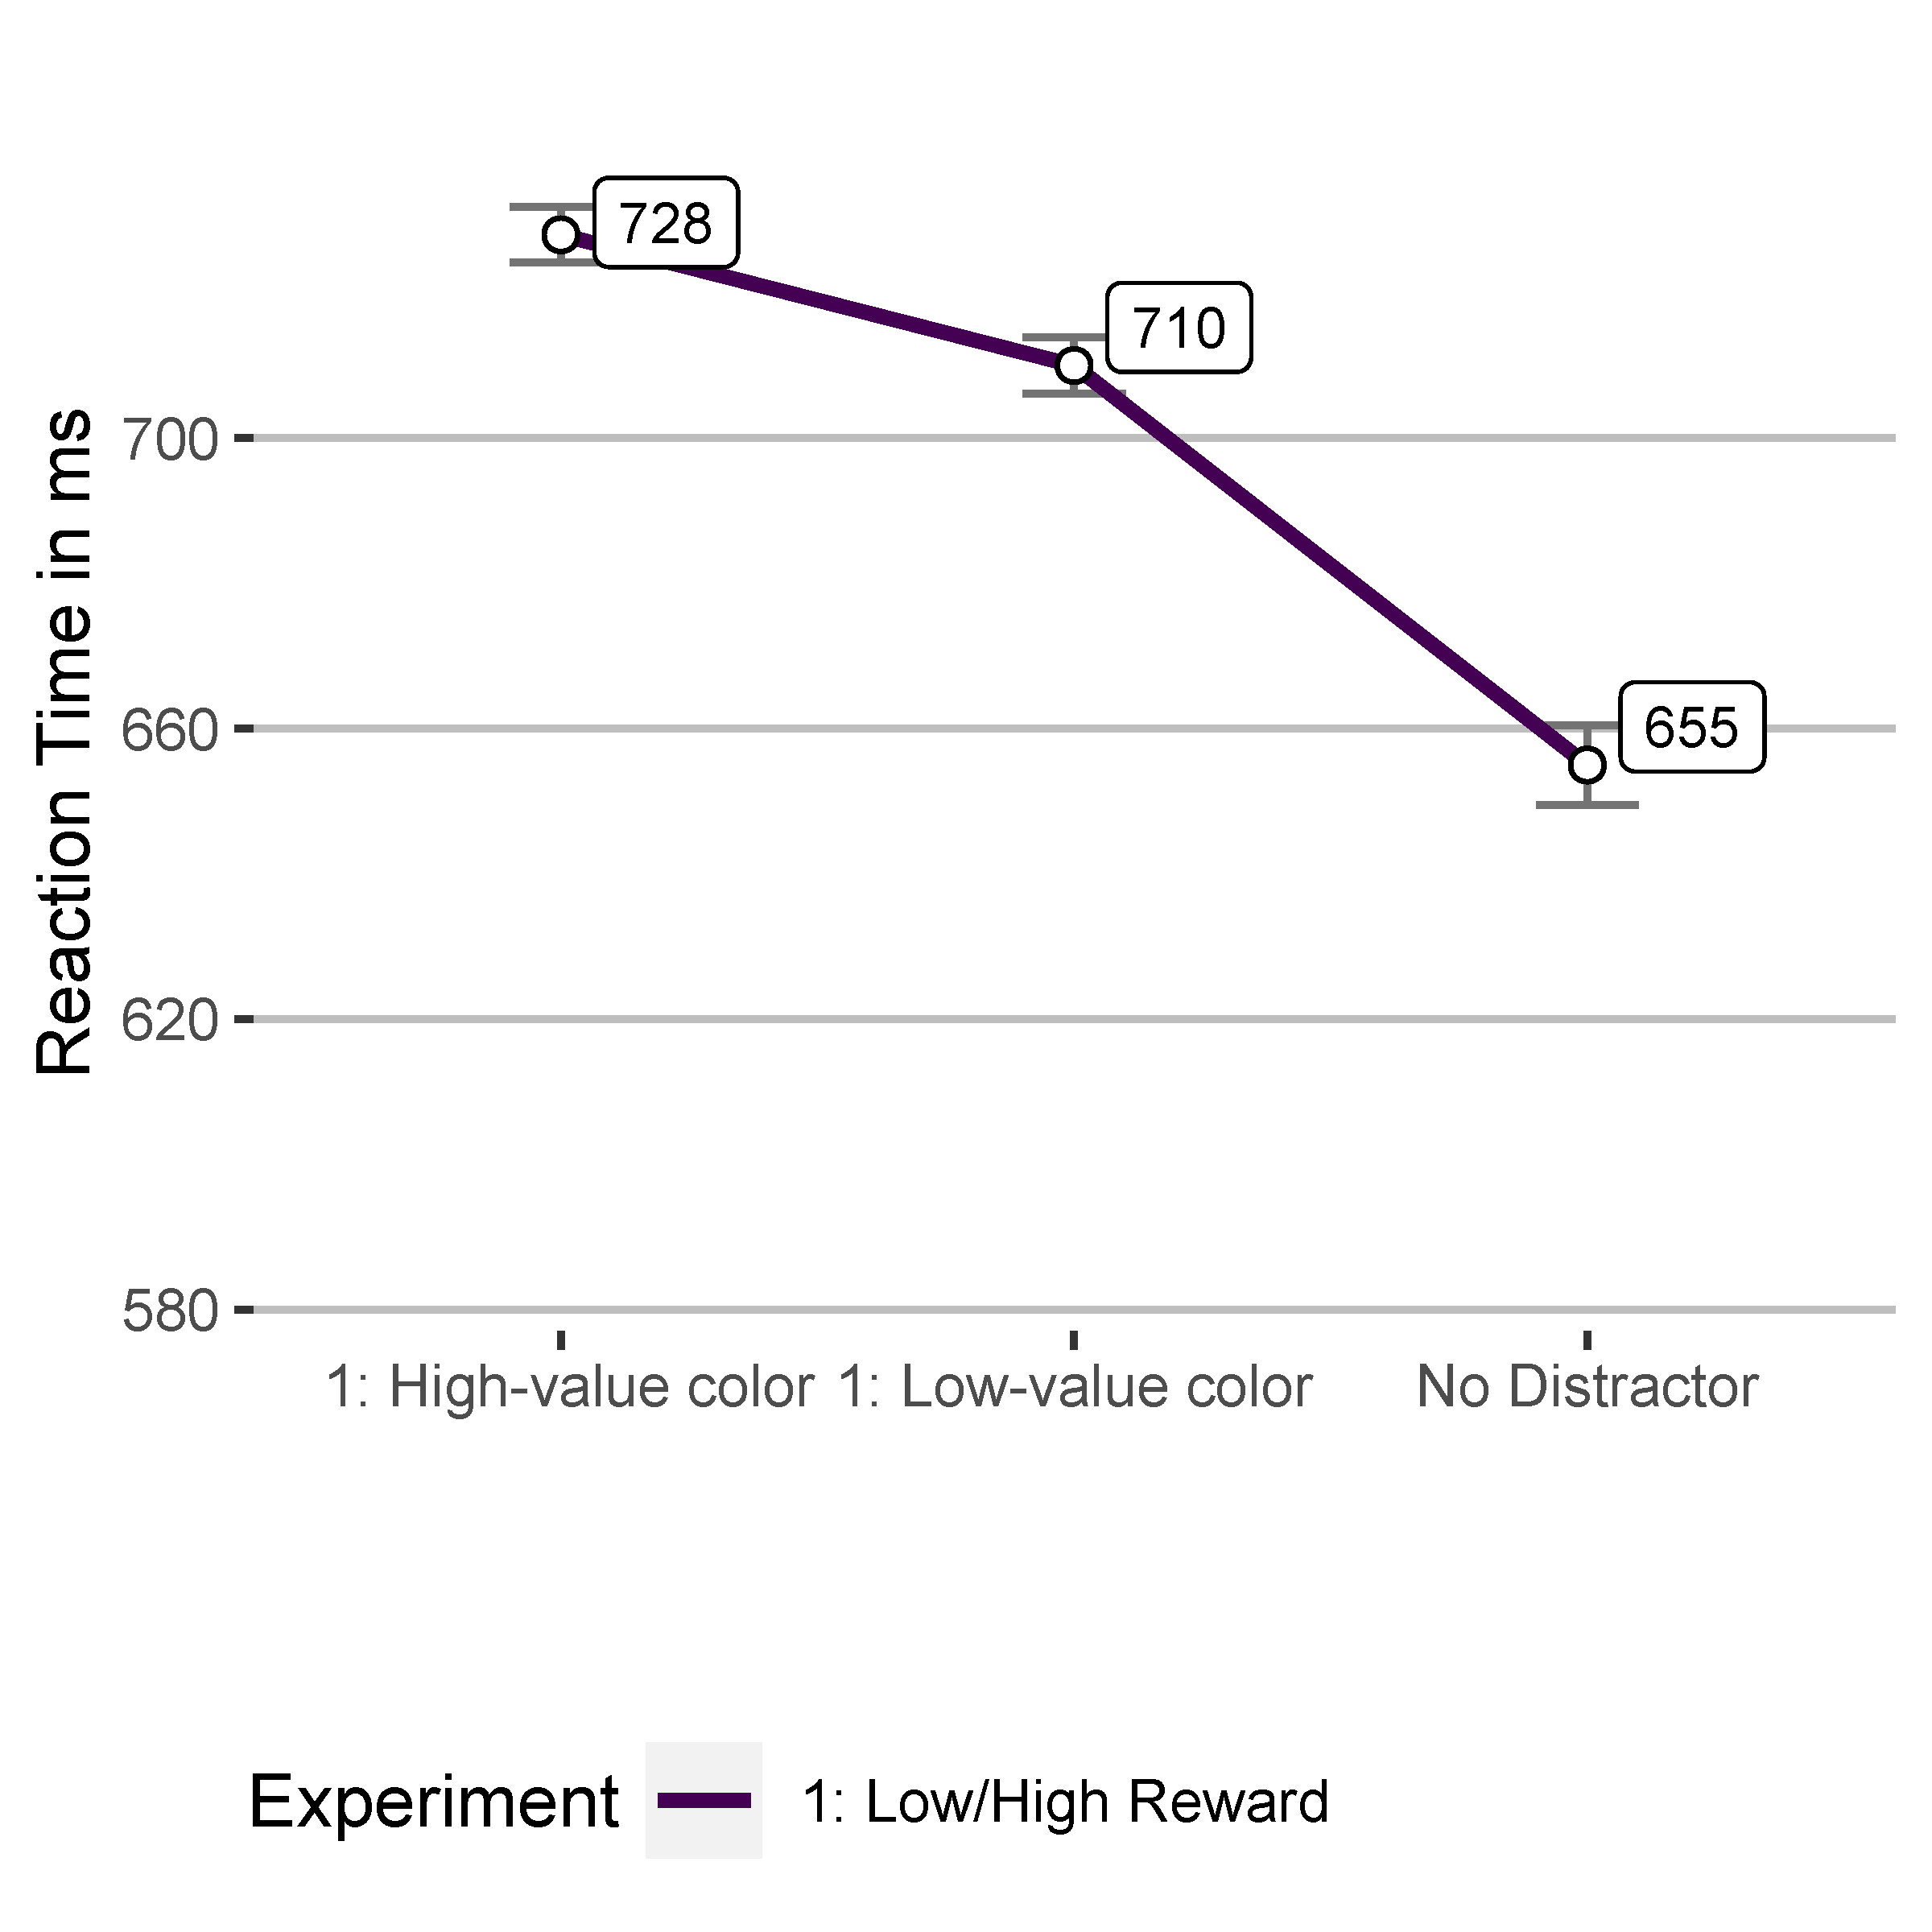
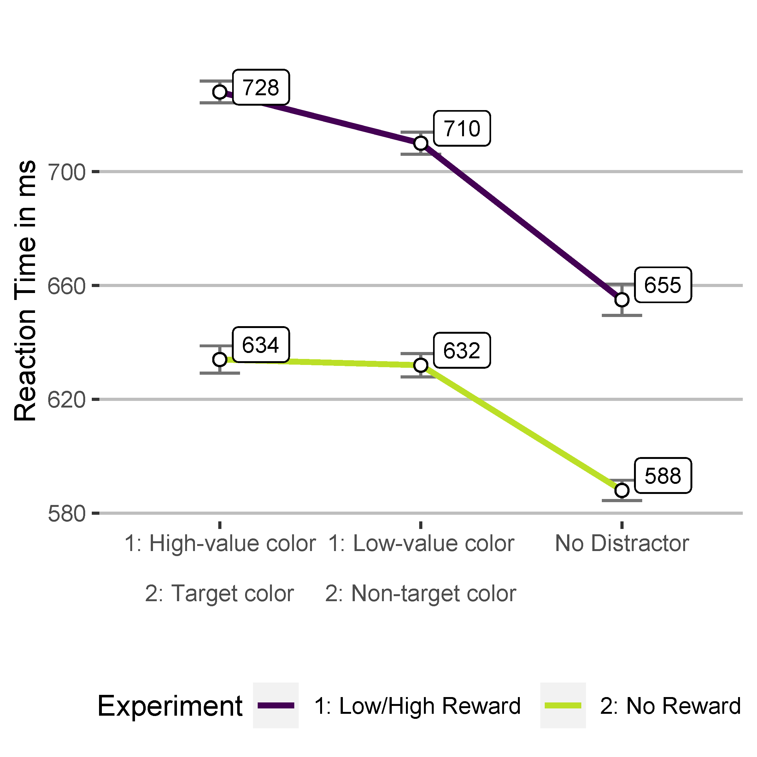
Reward and attentional capture
Increased distraction
Reward increases salience
Similar distraction
Training phase
Test phase
Anderson, B. A., Laurent, P. A., & Yantis, S. (2011). Learned value magnifies salience-based attentional capture. PLoS ONE, 6(11), e27926. https://doi.org/10.1371/journal.pone.0027926

Slide 4
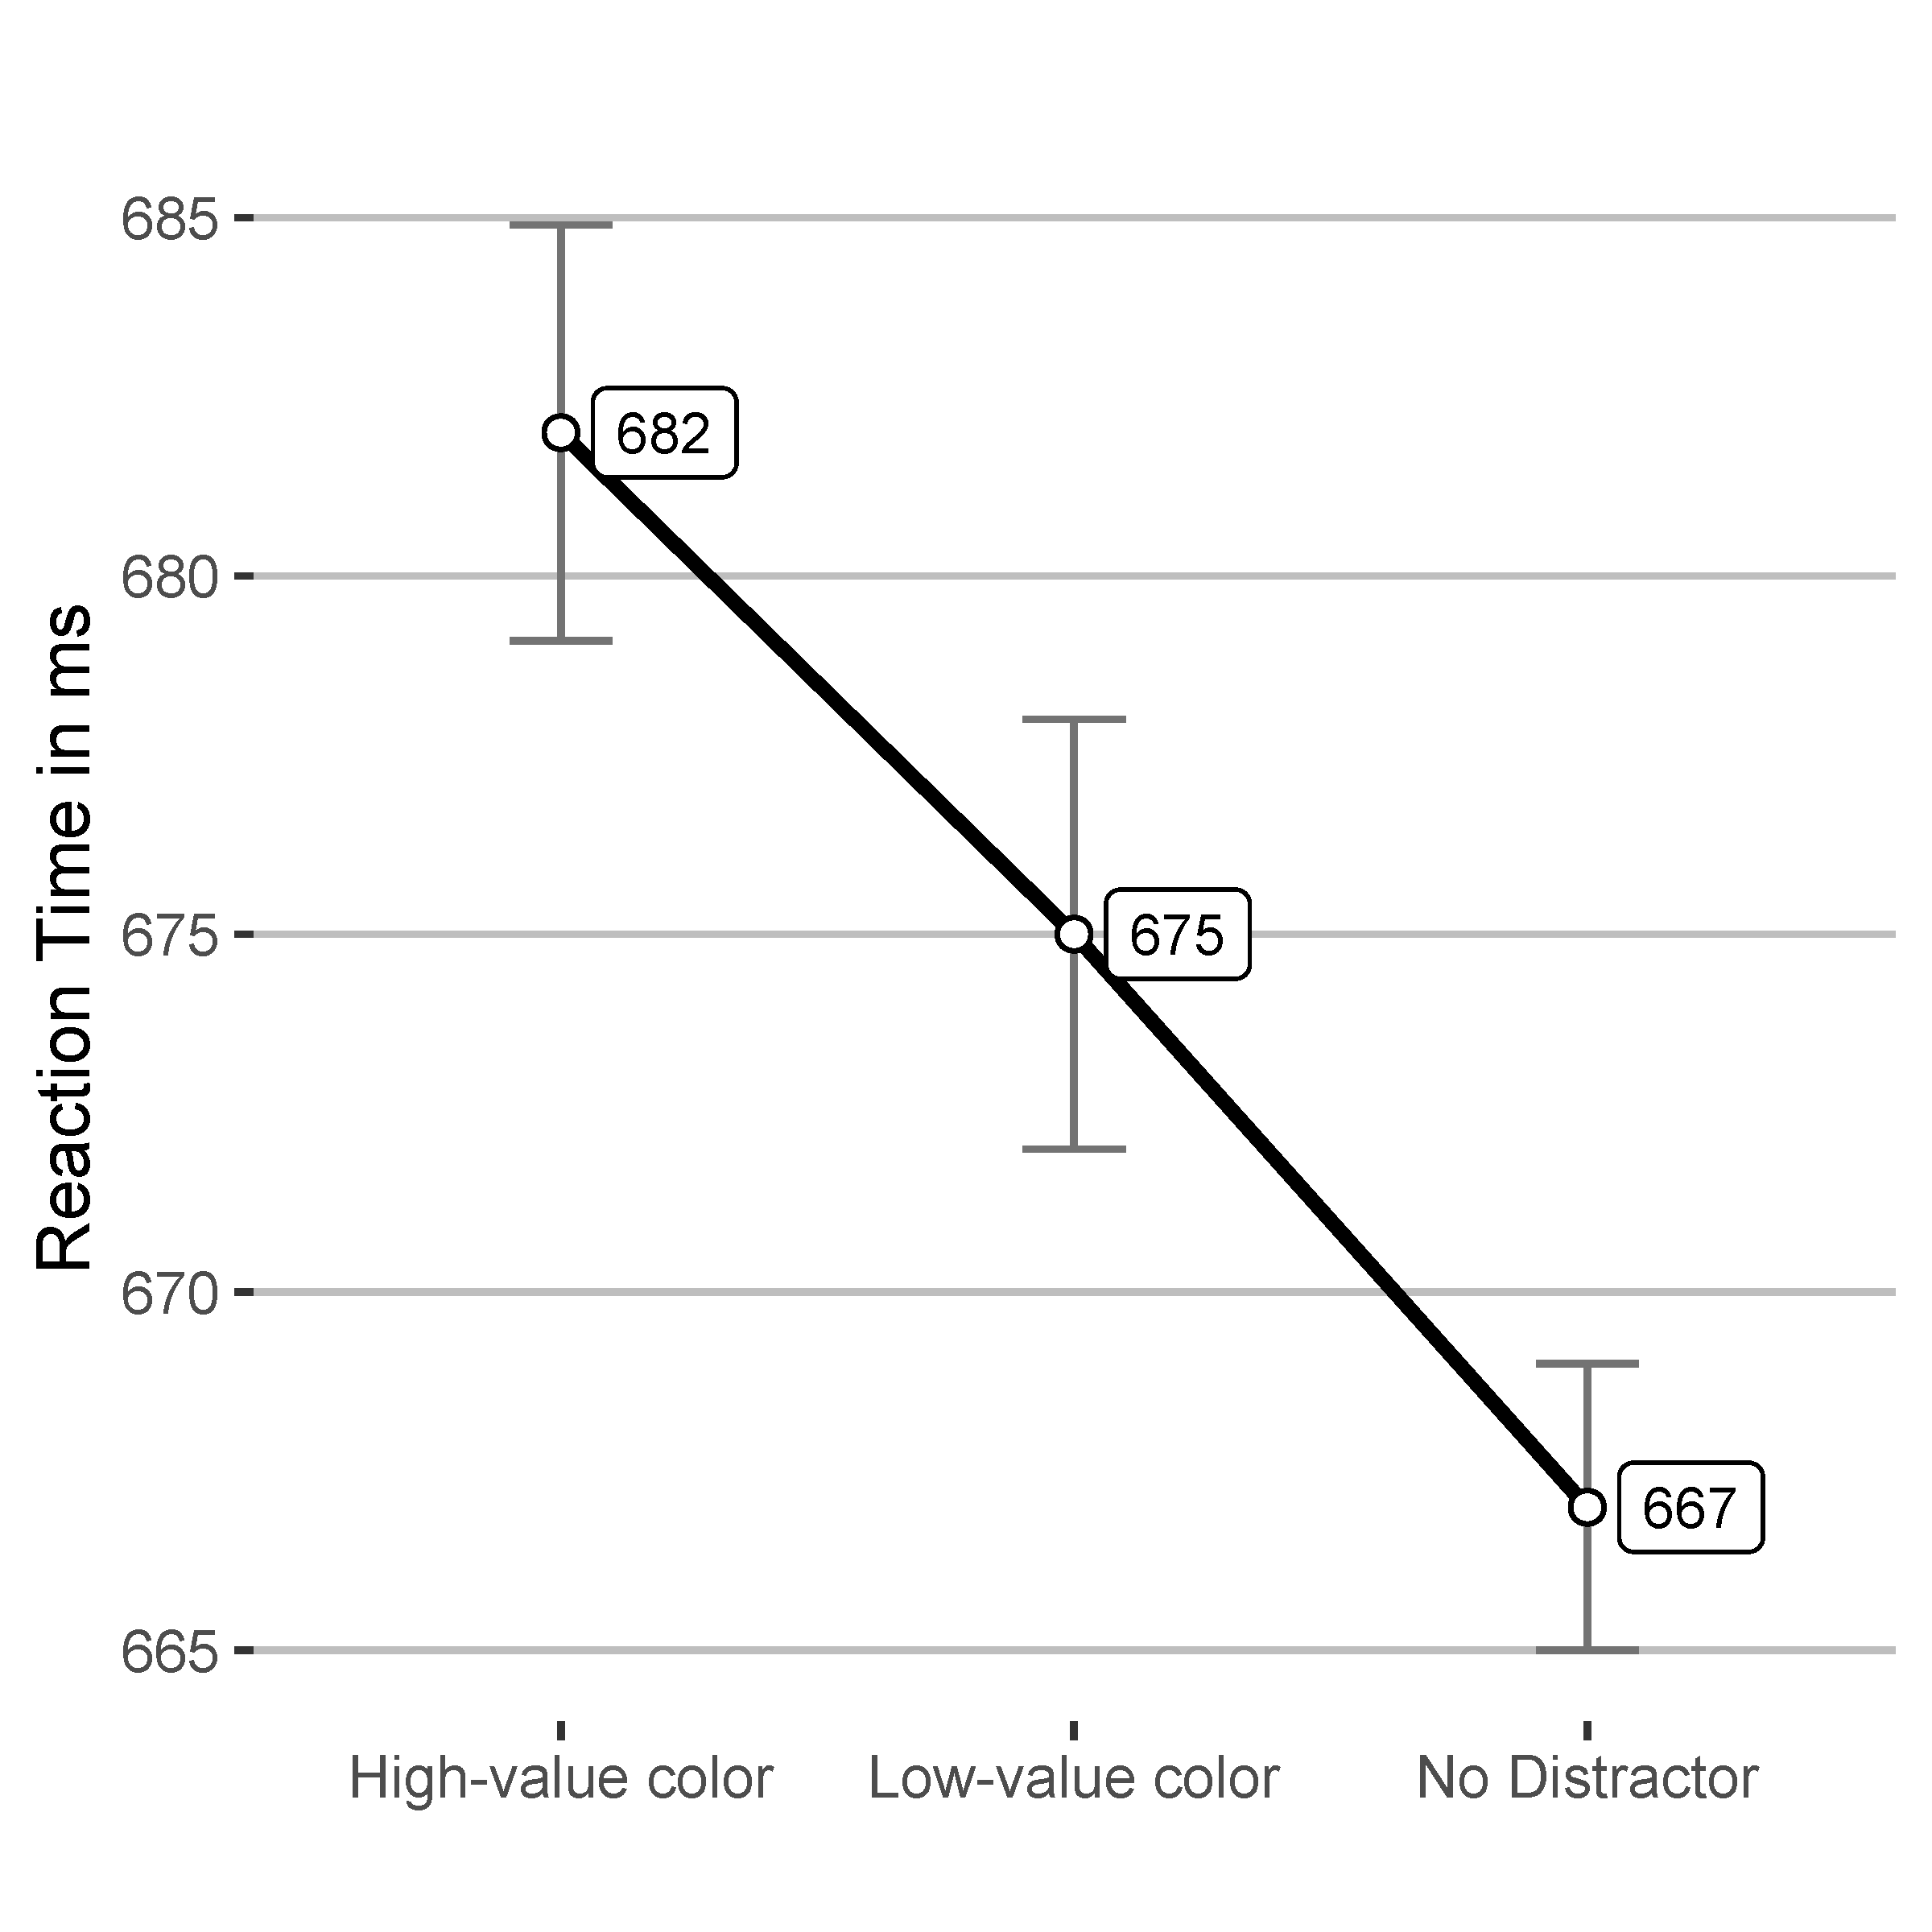
Reward and attentional capture
Independent of bottom-up and top-down influences
Increased distraction
(15 ms)
Training phase
Test phase
Anderson, B. A., Laurent, P. A., & Yantis, S. (2011). Value-driven attentional capture. Proceedings of the National Academy of Sciences of the United States of America, 108(25), 10367–10371. https://doi.org/10.1073/pnas.1104047108

Slide 5
Really independent of task-relevance?
Contingent capture of attention (Folk et al., 1992)
Only features matching the search goal capture attention
Search mode influences task-relevance of singletons (Bacon & Egeth, 1994)
Singletons are task-relevant during search for singletons
Bacon, W. F., & Egeth, H. E. (1994). Overriding stimulus-driven attentional capture. Perception & Psychophysics, 55(5), 485–496. https://doi.org/10.3758/BF03205306
Folk, C. L., Remington, R. W., & Johnston, J. C. (1992). Involuntary covert orienting is contingent on attentional control settings. Journal of Experimental Psychology: Human Perception and Performance, 18(4), 1030–1044. https://doi.org/10.1037/0096-1523.18.4.1030

Slide 6
Alternative Explanation
Reward increased salience of a specific color
That color stands out among other colors without reward-association
It might be processed as a singleton
The reward-associated color is task-relevant during singleton search

Slide 7
Our study
Investigating reward-driven attentional capture during feature search
Design similar to Anderson et al. (2011)
Training block
Singleton search
Feature search
Awareness of reward-association recorded
Dialog window after Training phase
Preregistered at the Open Science Framework (OSF)
Order balanced

Slide 8
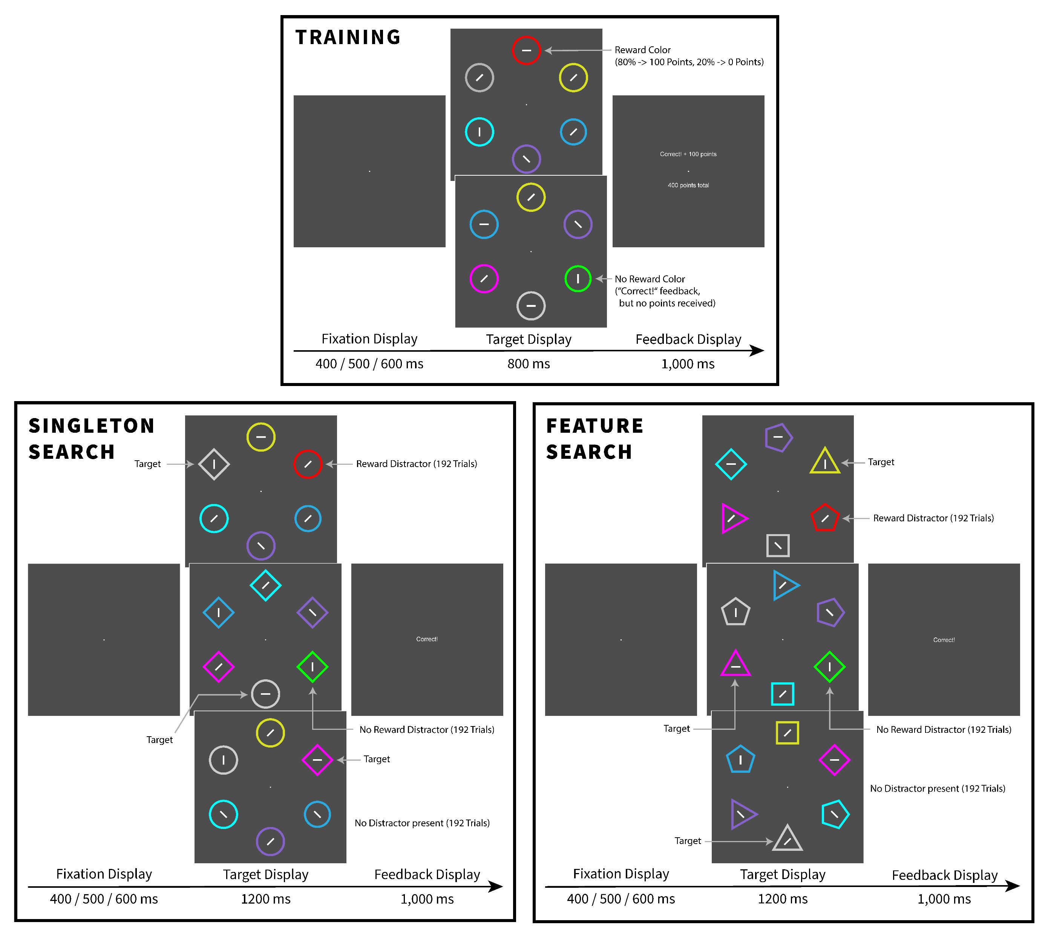
Training
Partial reinforcement.
Sample
N = 45
29 Women, 16 Men
19–39 years
Mdn = 23
24 did not notice reward-association
Task
Search for red or green
Respond to line orientation
Only selection.

Slide 9
Singleton Search
Task
Search for the shape singleton
Respond to line orientaton

Slide 10
Feature Search
Task
Search for the triangle pointing upwards
Respond to line orientaton

Slide 11
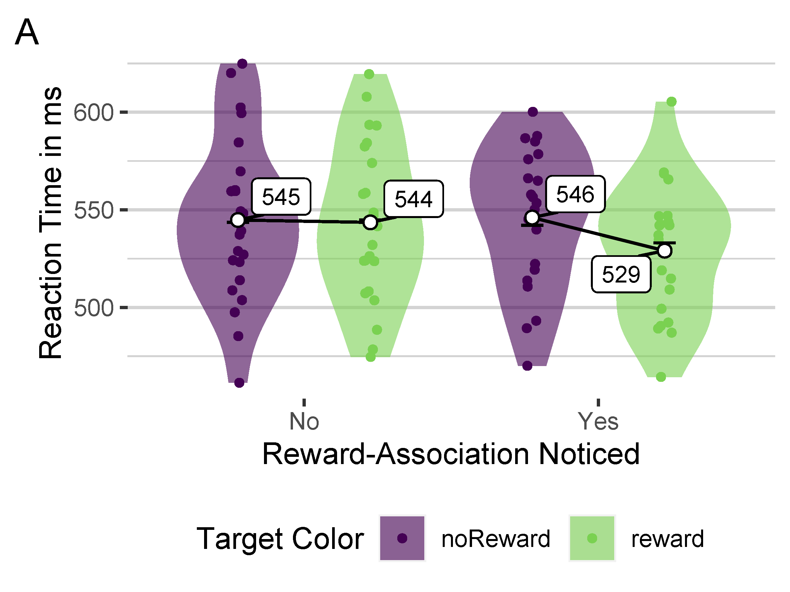
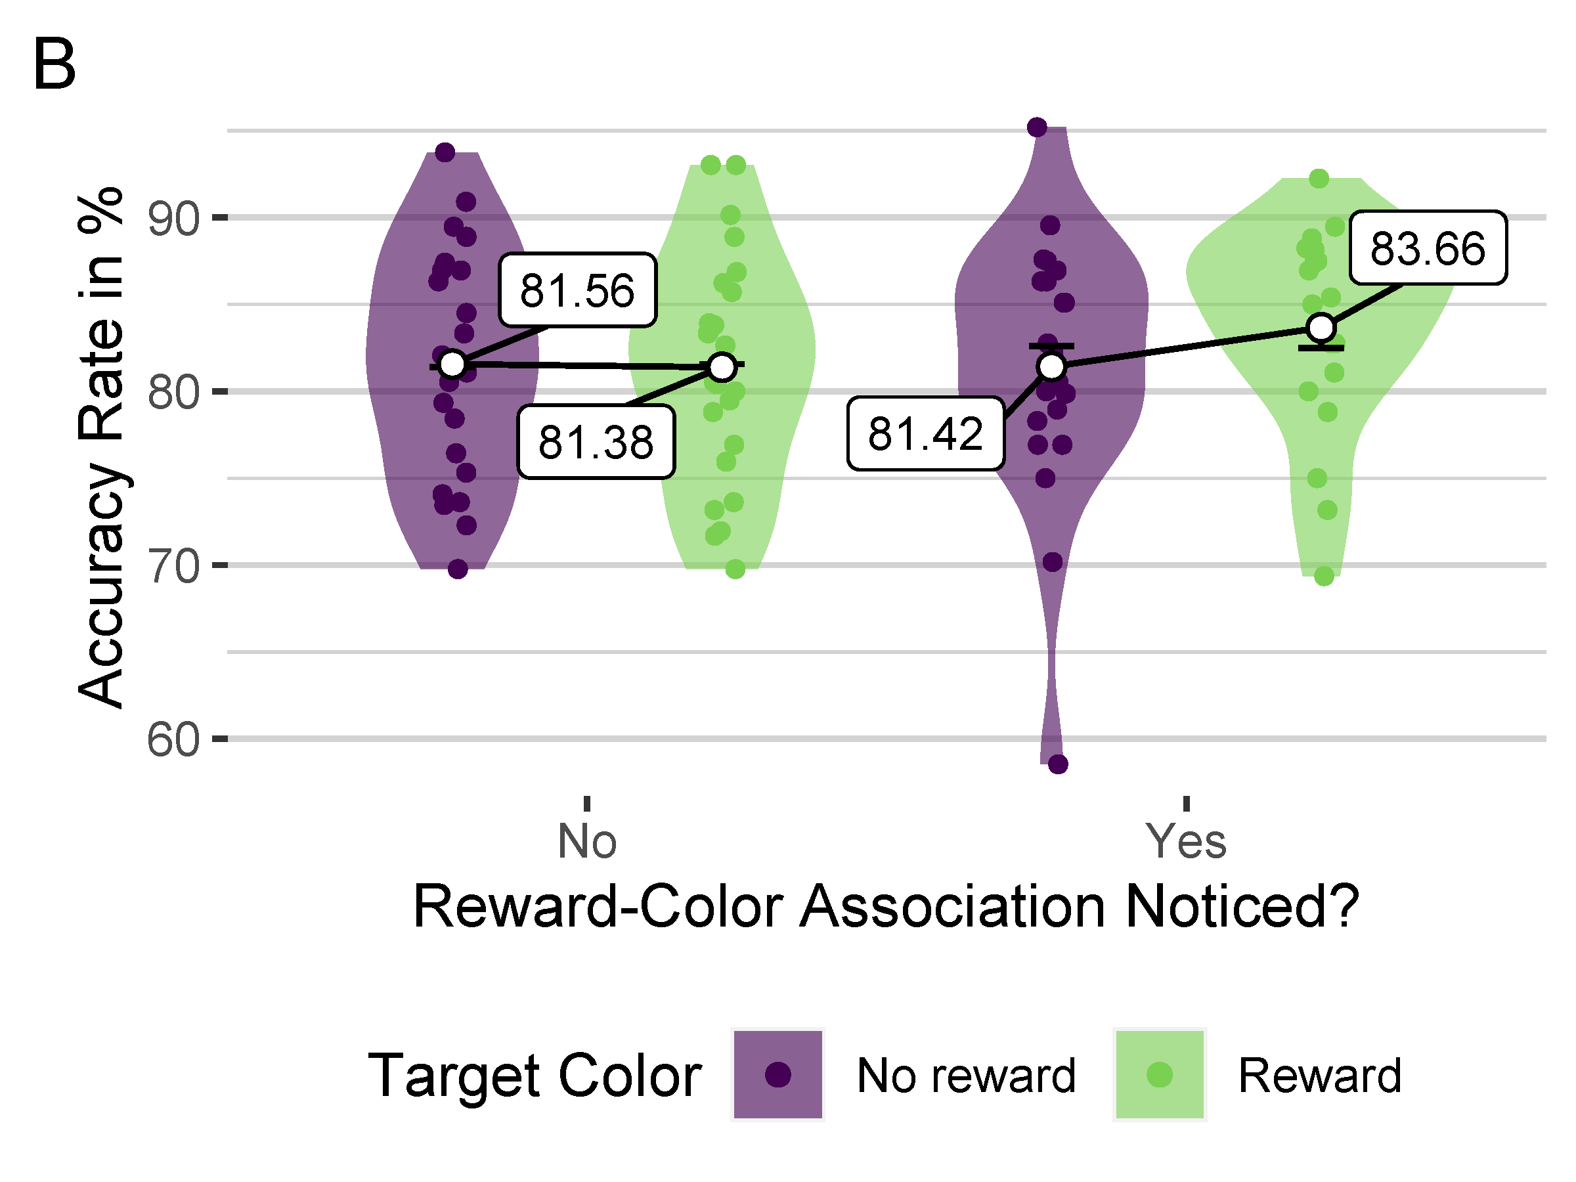
Results: Training

Slide 12
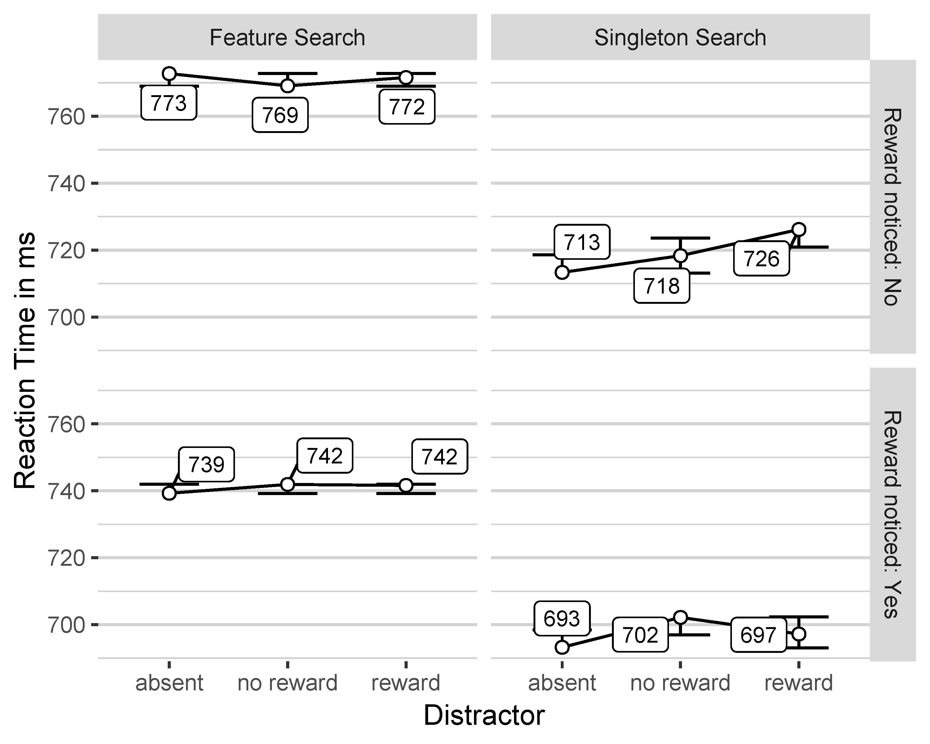
Reaction Times

Slide 13
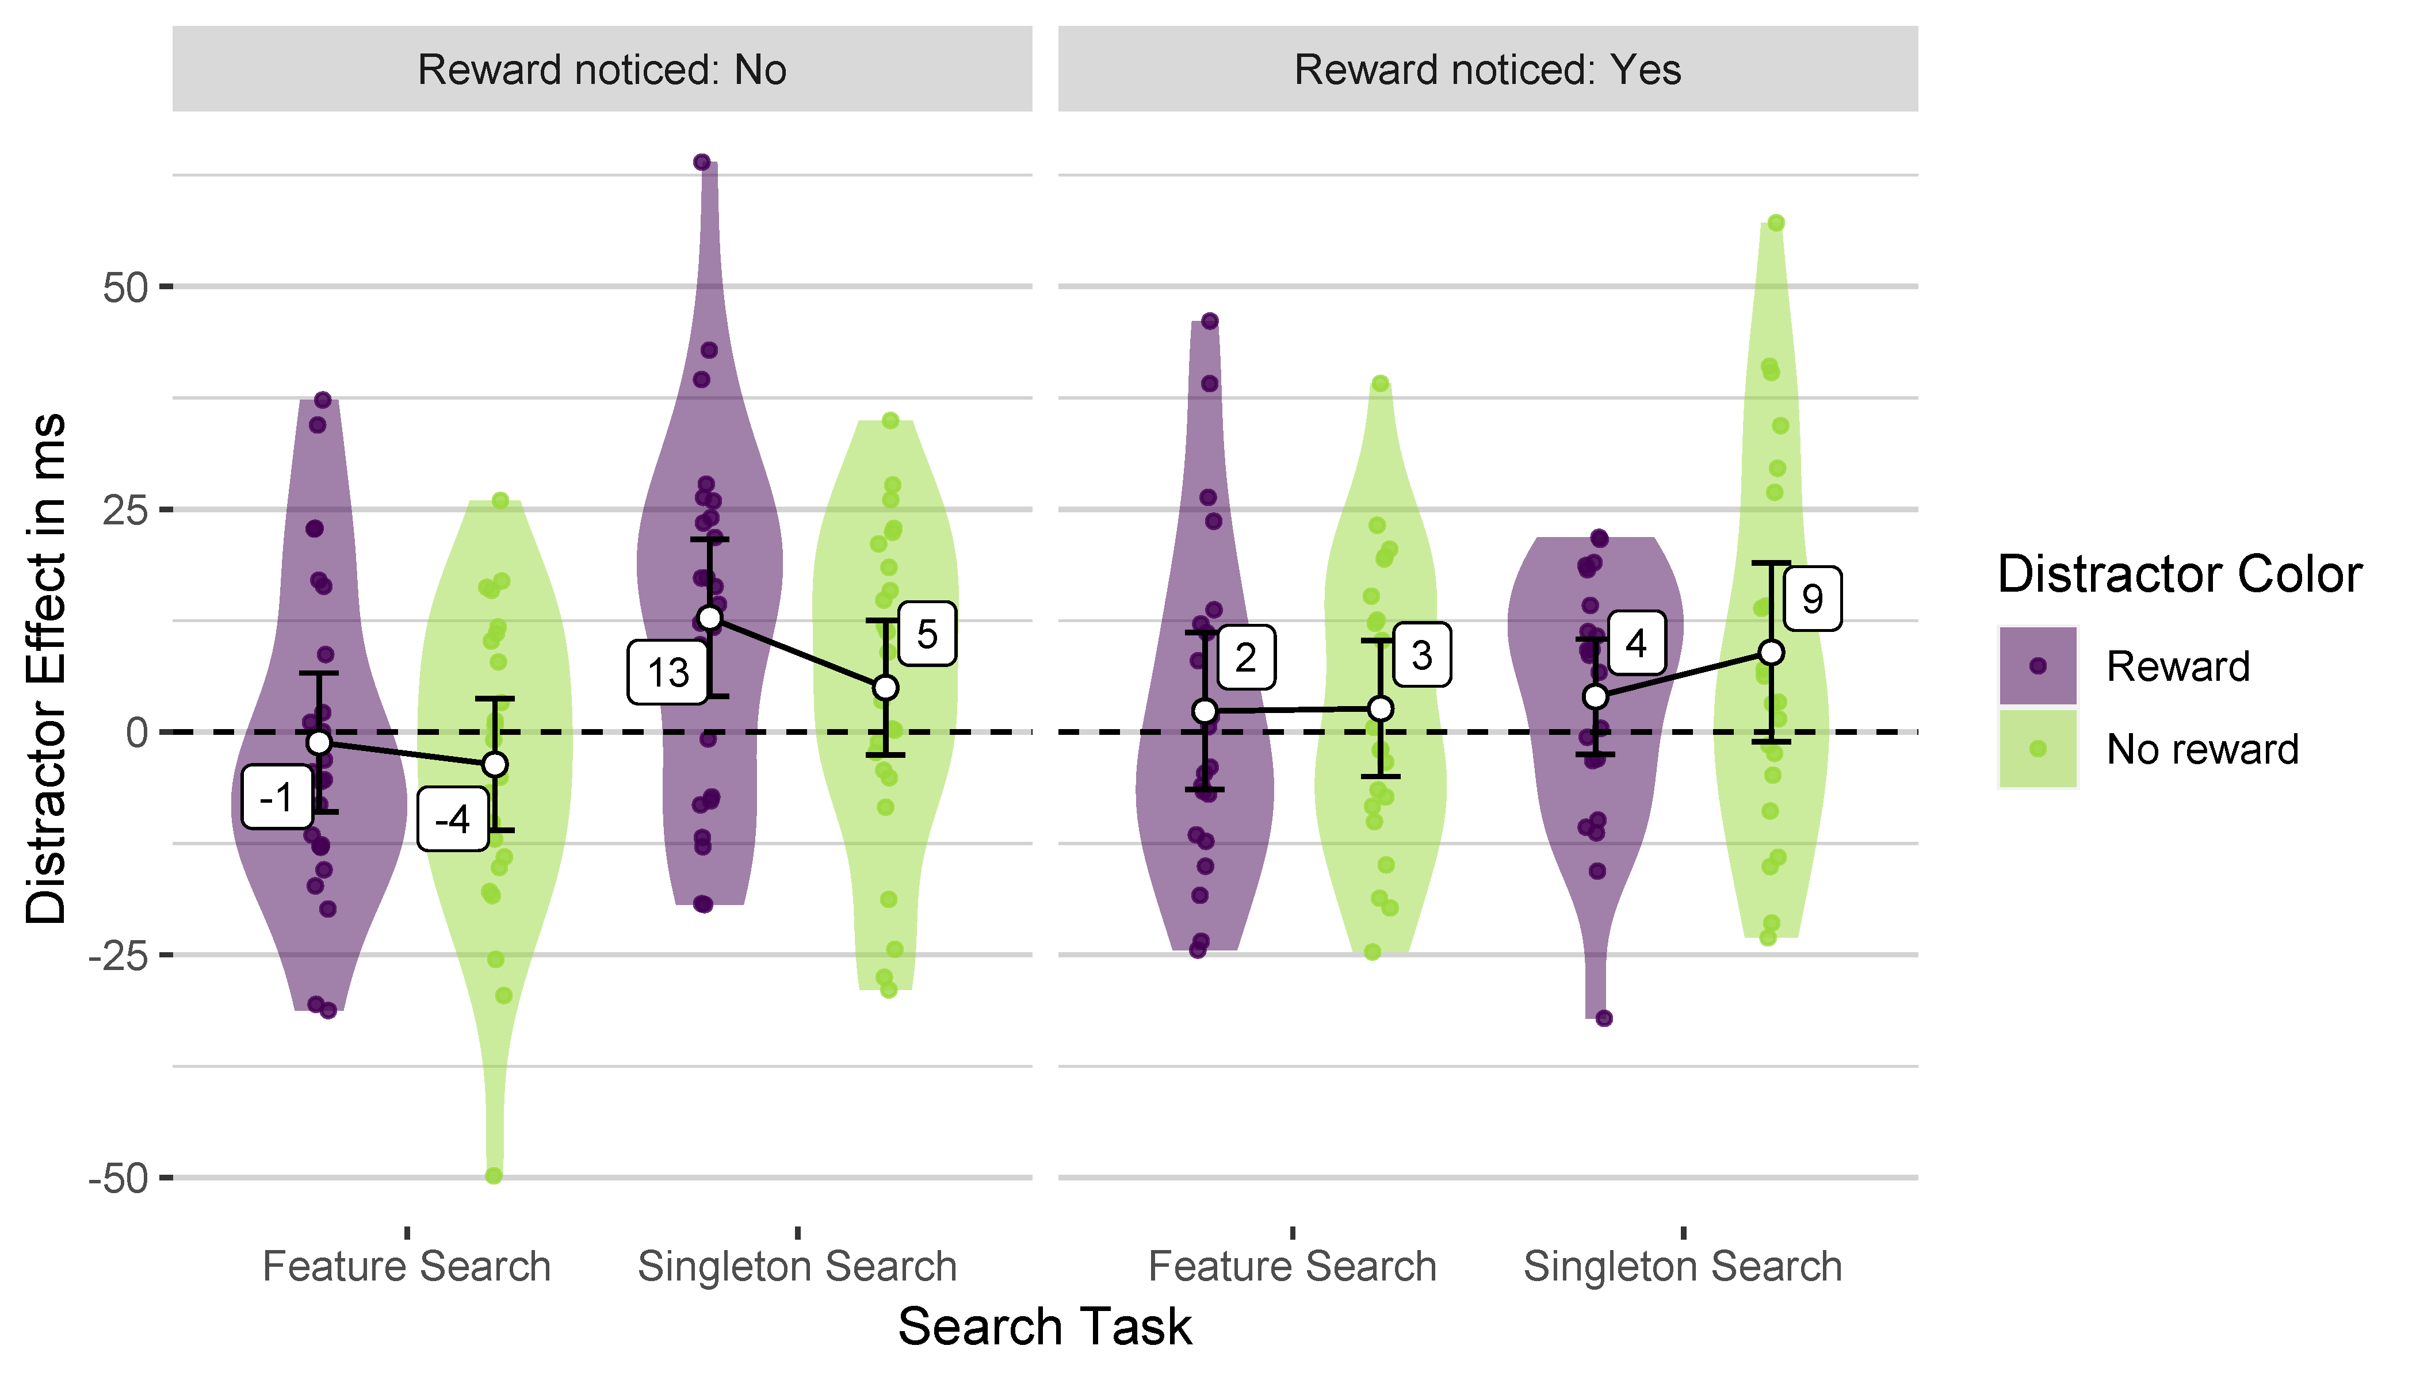
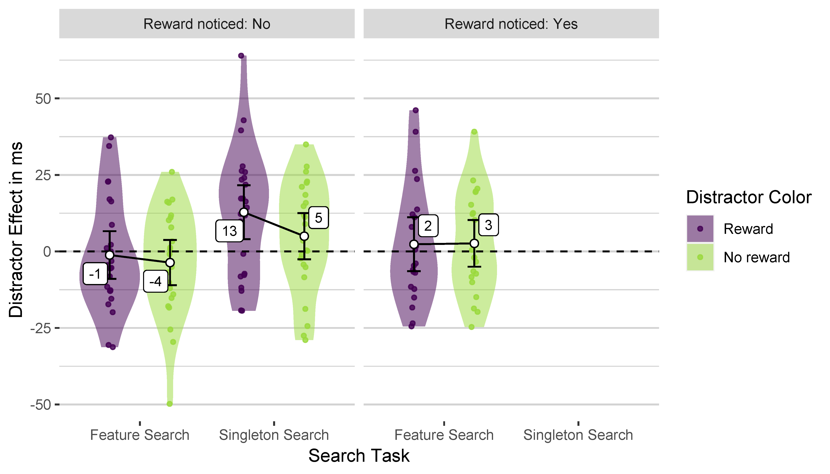
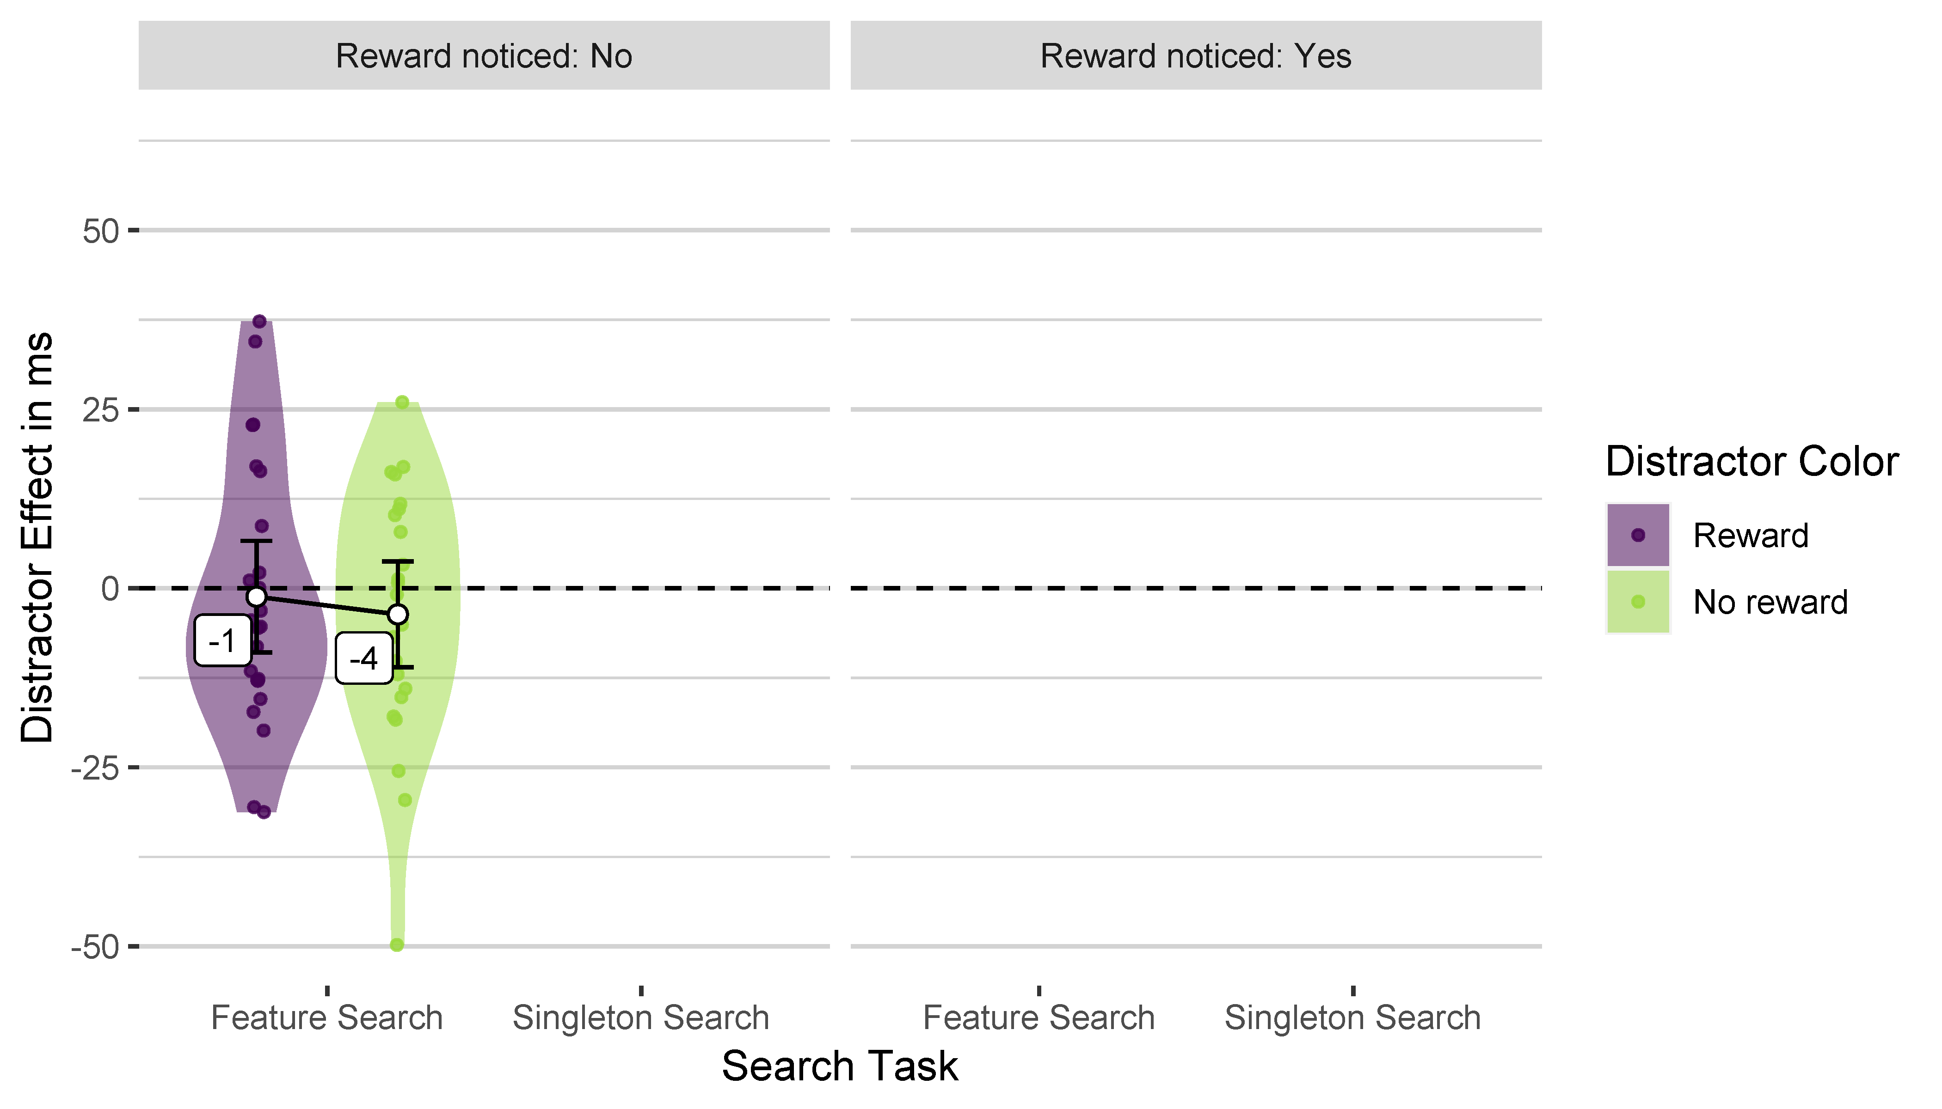
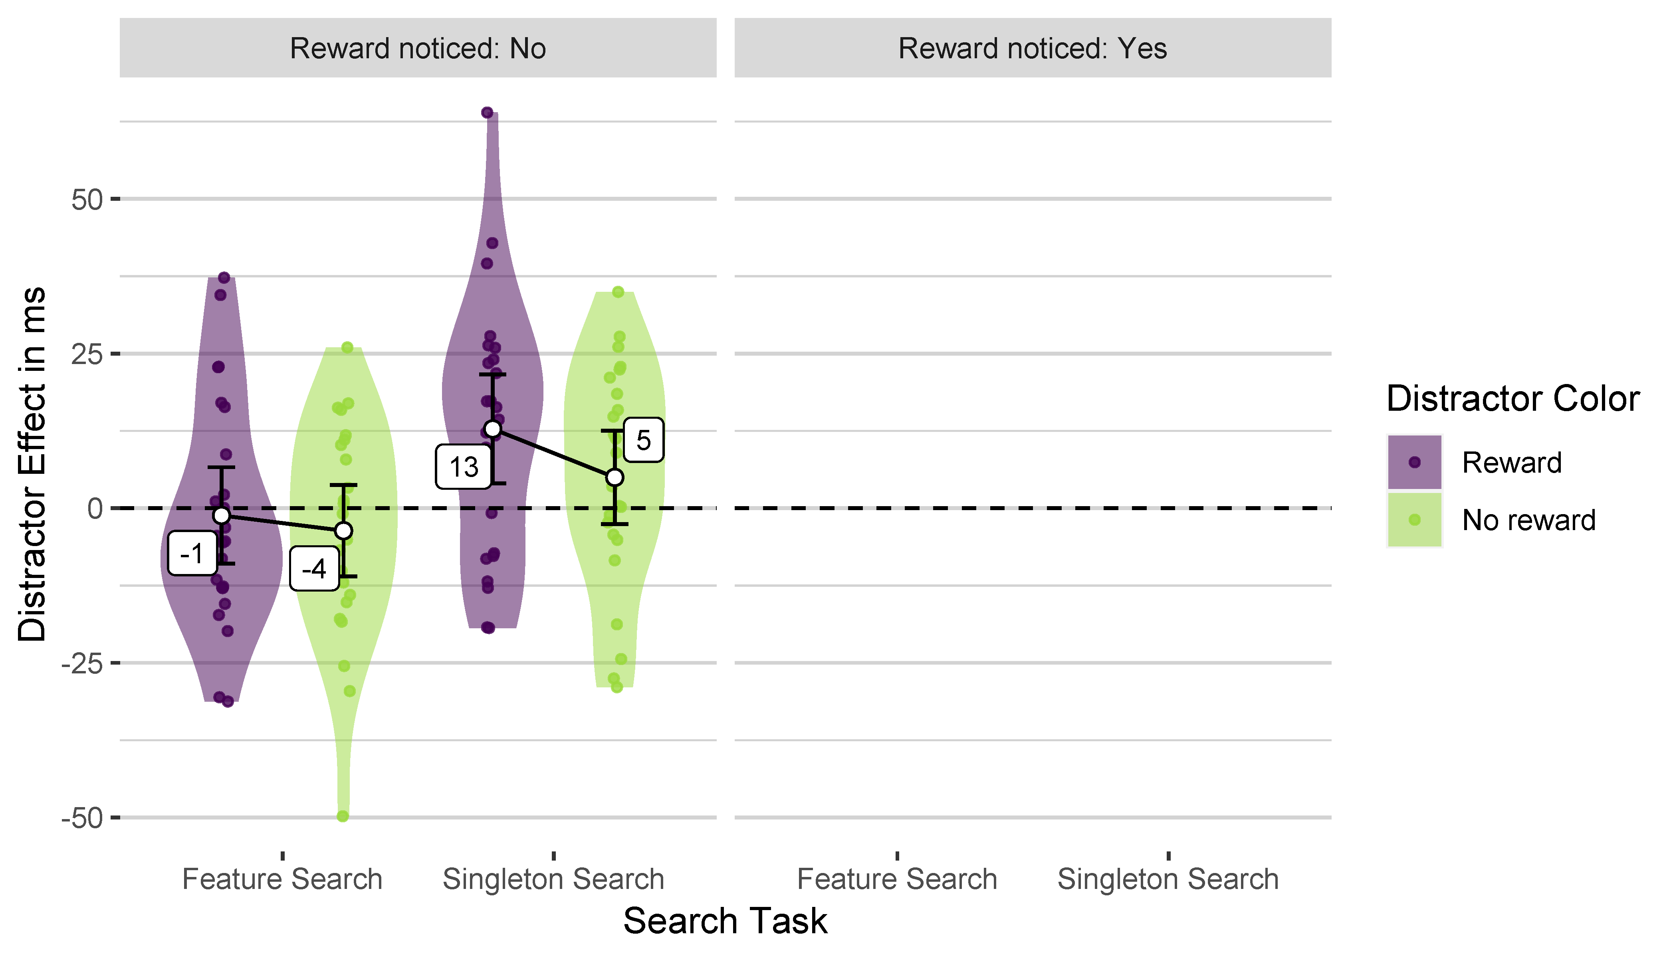
Distractor Effects

Slide 14
Summary
Replication of value-driven attention in singleton search …
Only if participants were naive to the reward-color association
M = 13 ms, unbiased Cohens d = 0.59, 95% CI [0.17, 1.05]
But no evidence in participants who noticed the reward-color association
M = 4 ms, unbiased Cohens d = 0.27, 95% CI [−0.16, 0.71]
No evidence for value-driven attention in feature search
Independent of awareness
Association noticed: M = −1 ms, unbiased Cohens d = −0.06, 95% CI [−0.46, 0.34]
Naive: M = 2 ms, unbiased Cohens d = 0.12, 95% CI [−0.31, 0.55]
No evidence for attentional capture by previous target colors

Slide 15
Conclusion
Value-driven attentional capture does not violate goal-driven accounts of visual attentinal guidance
No distraction if rewarded color is really task-irrelevant
No evidence for capture by selected but unrewarded colors
Awareness of a reward-associated feature might elicit voluntary use of that feature as search criterion.
Possible implicit influences of reward might be overwritten

